Slide 1
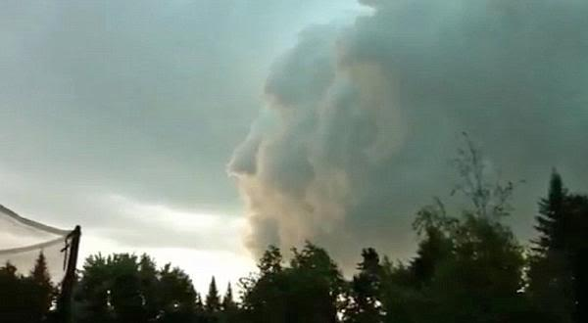

Slide 3
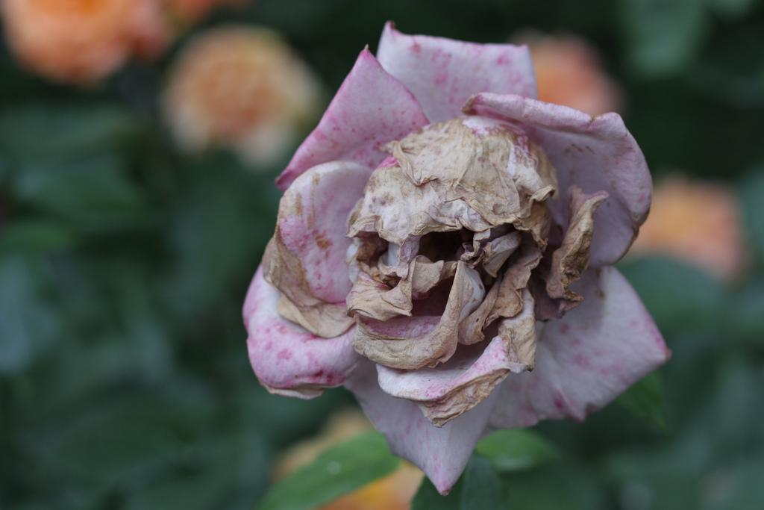
Notes:
http://farm5.staticflickr.com/4068/4681816734_615888029b_b.jpg

Slide 4
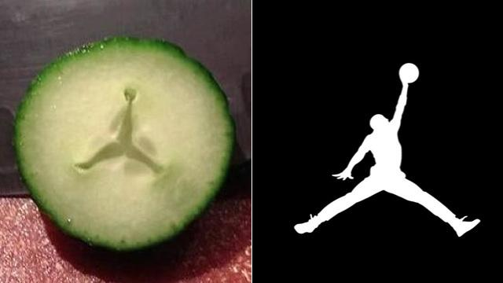

Slide 5
Notes:
http://chandra.harvard.edu/graphics/resources/desktops/2011/30dor_1920.jpg

Slide 6
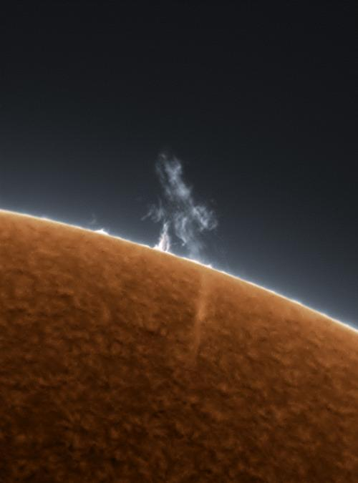
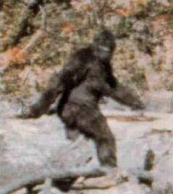
Notes:
http://25.media.tumblr.com/tumblr_lssy41rtKt1r1dma9o1_500.jpg

Slide 7
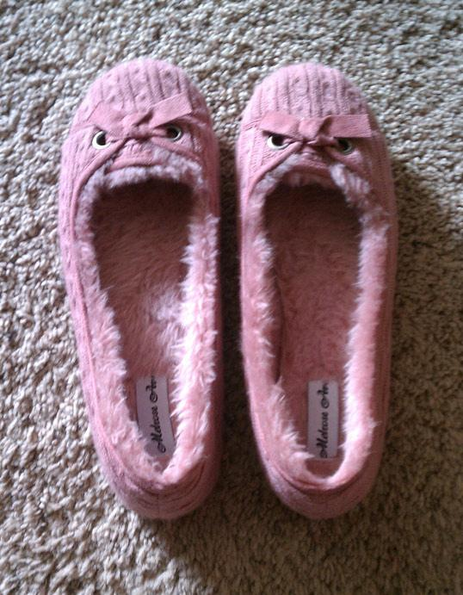

Slide 8
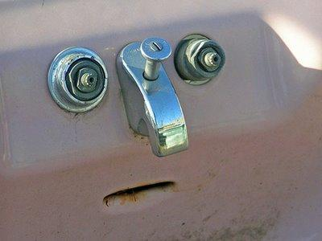

Slide 9
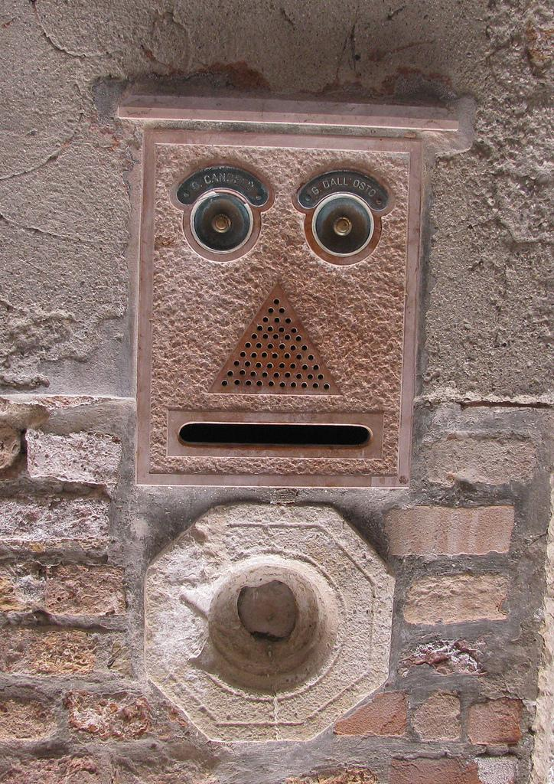
Notes:
http://farm6.staticflickr.com/5150/5730269330_11d2b6ea70_b.jpg

Slide 10
